Slide 1
Review of last lecture
There are two fundamentally different approaches to software design:
  function-oriented approach
  object-oriented approach
We looked at the essential philosophy of these two approaches:
  the approaches are not competing but complementary approaches.

Slide 2
Introduction
Function-oriented design techniques are very popular:
  currently in use in many software development organizations.
Function-oriented design techniques:
  start with the functional requirements specified in the SRS document.

Slide 3
Introduction
During the design process:
  high-level functions are successively decomposed:
    into more detailed functions.
  finally the detailed functions are mapped to a module structure.

Slide 4
Introduction
Successive decomposition of high-level functions:
  into more detailed functions.
  Technically known as top-down decomposition.

Slide 5
Introduction
SA/SD methodology:
  has essential features of several important function-oriented design methodologies ---
    if you need to use any specific design methodology later on,
    you can do so easily with small additional effort.

Slide 6
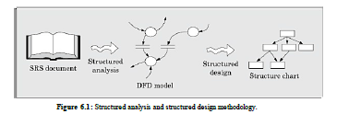
SA/SD Methodology

Slide 7
SA/SD (Structured Analysis/Structured Design)
SA/SD technique draws heavily from the following methodologies:
  Constantine and Yourdon's methodology
  Hatley and Pirbhai's methodology
  Gane and Sarson's methodology
  DeMarco and Yourdon's methodology
SA/SD technique can be used to perform
  high-level design.

Slide 8
Overview of SA/SD Methodology
SA/SD methodology consists of two distinct activities:
  Structured Analysis (SA)
  Structured Design (SD)
During structured analysis:
  functional decomposition takes place.
During structured design:
  module structure is formalized.

Slide 9
Functional decomposition
Each function is analyzed:
  hierarchically decomposed into more detailed functions.
  simultaneous decomposition of high-level data
    into more detailed data.

Slide 10
Structured analysis
Transforms a textual problem description into a graphic model.
  done using data flow diagrams (DFDs).
  DFDs graphically represent the results of structured analysis.

Slide 11
Structured design
All the functions represented in the DFD:
  mapped to a module structure.
The module structure:
  also called as the software architecture:

Slide 12
Detailed Design
Software architecture:
  refined through detailed design.
  Detailed design can be directly implemented:
    using a conventional programming language.

Slide 13
Structured Analysis vs. Structured Design
Purpose of structured analysis:
  capture the detailed structure of the system as the user views it.
Purpose of structured design:
  arrive at a form that is suitable for implementation in some programming language.

Slide 14
Structured Analysis vs. Structured Design
The results of structured analysis can be easily understood even by ordinary customers:
  does not require computer knowledge
  directly represents customer’s perception of the problem
  uses customer’s terminology for naming different functions and data.
The results of structured analysis can be reviewed by customers:
  to check whether it captures all their requirements.

Slide 15
Structured Analysis
Based on principles of:
  Top-down decomposition approach.
  Divide and conquer principle:
    each function is considered individually (i.e. isolated from other functions)
    decompose functions totally disregarding what happens in other functions.
  Graphical representation of results using
    data flow diagrams (or bubble charts).

Slide 16
Data flow diagrams
DFD is an elegant modelling technique:
  useful not only to represent the results of structured analysis
  applicable to other areas also:
    e.g. for showing the flow of documents or items in an organization,
DFD technique is very popular because
  it is simple to understand and use.

Slide 17
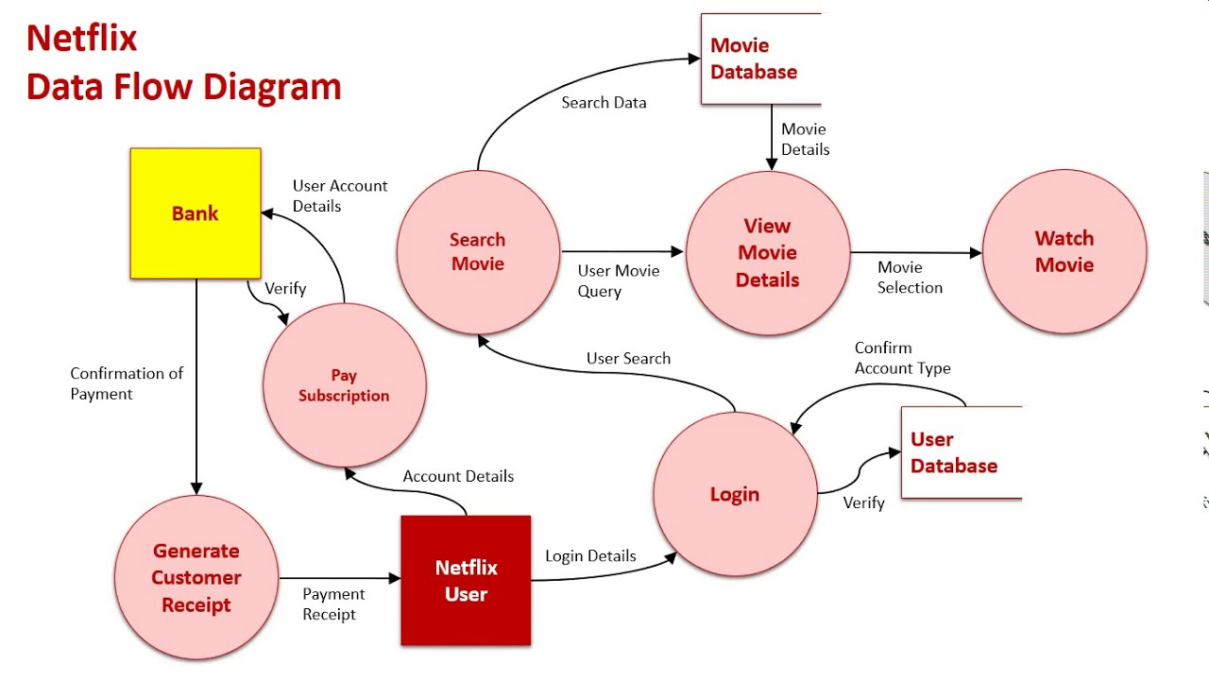

Slide 18
Data flow diagram
DFD is a hierarchical graphical model:
  shows the different functions (or processes) of the system and
  data interchange among the processes.

Slide 19
DFD Concepts
It is useful to consider each function as a processing station:
  each function consumes some input data and
  produces some output data.

Slide 20

Data Flow Model of a Car Assembly Unit
Engine Store
Door Store
Chassis with Engine
Partly Assembled Car
Fit
Engine
Fit
Doors
Fit
Wheels
Paint and
Test
Assembled Car
Car
Chassis Store
Wheel Store

Slide 21
Data Flow Diagrams (DFDs)
A DFD model:
  uses limited types of symbols.
  simple set of rules
  easy to understand:
    it is a hierarchical model.

Slide 22
Hierarchical model
Human mind can easily understand any hierarchical model:
  in a hierarchical model:
    we start with a very simple and abstract model of a system,
    details are slowly introduced through the hierarchies.

Slide 23
Hierarchical Model

Slide 24
How does the human mind work? (Digression)
search
store

Slide 25
How does the human mind work? (Digression)
Short term memory can hold upto 7 items:
  In Software Engineering the number 7 is called as the magic number.
An item is any set of related information (called a chunk):
  an integer
  a character
  a word
  a story
  a picture, etc

Slide 26
How does the human mind work? (Digression)
To store 1,9,6,5 requires 4 item spaces:
  but requires only one storage space when I recognize it as my year of birth.
It is not surprising that large numbers::
  usually broken down into several 3 or 4 digit numbers are easy to remember
  e.g. 61-9266-2948

Slide 27
Data Flow Diagrams (DFDs)
Primitive Symbols Used for Constructing DFDs:

Slide 28
External Entity Symbol
Represented by a rectangle
External entities are real
physical entities:
  input data to the system or
  consume data produced by the system.
  Sometimes external entities are called terminator, source, or sink.
Librarian

Slide 29
Function Symbol
A function such as “search-book” is represented using a circle:
  This symbol is called a
  process or bubble or transform.
  Bubbles are annotated with corresponding function names.
  Functions represent some activity:
    function names should be verbs.
search-book

Slide 30
Data Flow Symbol
A directed arc or line.
  represents data flow in the direction of the arrow.
  Data flow symbols are annotated with names of data they carry.
book-name

Slide 31
Data Store Symbol
Represents a logical file:
  A logical file can be:
    a data structure
    a physical file on disk.
  Each data store is connected to a process:
    by means of a data flow symbol.
book-details

Slide 32
Data Store Symbol
Direction of data flow arrow:
  shows whether data is being read
  from or written into it.
An arrow into or out of a data store:
  implicitly represents the entire data of the data store
  arrows connecting to a data store need not be annotated with any data name.
find-book
Books

Slide 33
Synchronous operation
If two bubbles are directly connected by a data flow arrow:
  they are synchronous
Read-numbers
0.1
number
Validate-numbers
0.2
Valid number
Data-items

Slide 34
Asynchronous operation
If two bubbles are connected via a data store:
  they are not synchronous.
Read-numbers
0.1
Validate-numbers
0.2
numbers
Valid number
Data-items

Slide 35
Yourdon's vs. Gane Sarson Notations
The notations that we would be following are closer to the Yourdon's notations
You may sometimes find notations in books that are slightly different
  For example, the data store may look like a box with one end closed

Slide 36
How is Structured Analysis Performed?
Initially represent the software at the most abstract level:
  called the context diagram.
  the entire system is represented as a single bubble,
  this bubble is labelled according to the main function of the system.

Slide 37
Tic-tac-toe: Context Diagram
Tic-tac-toe software
display
move
Human Player

Slide 38
Context Diagram
A context diagram shows:
  data input to the system,
  output data generated by the system,
  external entities.

Slide 39
Context Diagram
Context diagram captures:
  various entities external to the system and interacting with it.
  data flow occurring between the system and the external entities.
The context diagram is also called as the level 0 DFD.

Slide 40
Context Diagram
Context diagram
  establishes the context of the system, i.e.
  represents:
    Data sources
    Data sinks (receive incoming events).

Slide 41
Level 1 DFD
Examine the SRS document:
  Represent each high-level function as a bubble.
  Represent data input to every high-level function.
  Represent data output from every high-level function.

Slide 42
Higher level DFDs
Each high-level function is separately decomposed into subfunctions:
  identify the subfunctions of the function
  identify the data input to each subfunction
  identify the data output from each subfunction
These are represented as DFDs.

Slide 43
Decomposition
Decomposition of a bubble:
  also called factoring or exploding.
Each bubble is decomposed to
  between 3 to 7 bubbles.

Slide 44
Decomposition
Too few bubbles make decomposition superfluous:
  if a bubble is decomposed to just one or two bubbles:
    then this decomposition is redundant.

Slide 45
Decomposition
Too many bubbles:
  more than 7 bubbles at any level of a DFD
  make the DFD model hard to understand.

Slide 46
Decompose how long?
Decomposition of a bubble should be carried on until:
  a level at which the function of the bubble can be described using a simple algorithm.

Slide 47
Example 1: RMS Calculating Software
Consider a software called RMS calculating software:
  reads three integers in the range of -1000 and +1000
  finds out the root mean square (rms) of the three input numbers
  displays the result.

Slide 48
Example 1: RMS Calculating Software
The context diagram is simple to develop:
  The system accepts 3 integers from the user
  returns the result to him.

Slide 49
Example 1: RMS Calculating Software
Data-items
Compute- RMS
0
User
result
Context Diagram

Slide 50
Example 1: RMS Calculating Software
From a cursory analysis of the problem description:
  we can see that the system needs to perform several things.

Slide 51
Example 1: RMS Calculating Software
Accept input numbers from the user:
  validate the numbers,
  calculate the root mean square of the input numbers
  display the result.

Slide 52
Example 1: RMS Calculating Software
numbers
Read-numbers
0.1
Validate-numbers
0.2
Valid -numbers
Data-items
error
Compute-rms
0.3
Display
0.4
result
RMS

Slide 53
Example 1: RMS Calculating Software
Squared-sum
Calculate-squared-sum
0.3.1
Calculate-mean
0.3.2
Valid -numbers
Mean-square
Calculate-root
0.3.3
RMS

Slide 54
Example: RMS Calculating Software
b
a
c
Square
0.3.1.1
Square
0.3.1.2
Square
0.3.1.3
bsq
asq
csq
Sum
0.3.1.4
Squared-sum

Slide 55
Example: RMS Calculating Software
Decomposition is never carried on up to basic instruction level:
  a bubble is not decomposed any further:
    if it can be represented by a simple set of instructions.

Slide 56
Data Dictionary
A DFD is always accompanied by a data dictionary.
A data dictionary lists all data items appearing in a DFD:
  definition of all composite data items in terms of their component data items.
  all data names along with the purpose of data items.
For example, a data dictionary entry may be:
  grossPay = regularPay+overtimePay

Slide 57
Importance of Data Dictionary
Provides all engineers in a project with standard terminology for all data:
  A consistent vocabulary for data is very important
  different engineers tend to use different terms to refer to the same data,
    causes unnecessary confusion.

Slide 58
Importance of Data Dictionary
Data dictionary provides the definition of different data:
  in terms of their component elements.
For large systems,
  the data dictionary grows rapidly in size and complexity.
  Typical projects can have thousands of data dictionary entries.
  It is extremely difficult to maintain such a dictionary manually.

Slide 59
Data Dictionary
CASE (Computer Aided Software Engineering) tools come handy:
  CASE tools capture the data items appearing in a DFD automatically to generate the data dictionary.

Slide 60
Data Dictionary
CASE tools support queries:
  about definition and usage of data items.
For example, queries may be made to find:
  which data item affects which processes,
  a process affects which data items,
  the definition and usage of specific data items, etc.
Query handling is facilitated:
  if data dictionary is stored in a relational database management system (RDBMS).

Slide 61
Data dictionary for RMS Software
numbers=valid-numbers=a+b+c
a:integer * input number *
b:integer * input number *
c:integer * input number *
asq:integer
bsq:integer
csq:integer
squared-sum: integer
Result=[RMS,error]
RMS: integer * root mean square value*
error:string * error message*

Slide 62
Balancing a DFD
Data flowing into or out of a bubble:
  must match the data flows at the next level of DFD.
  This is known as balancing a DFD
In the level 1 of the DFD,
  data item c flows into the bubble P3 and the data item d and e flow out.
In the next level, bubble P3 is decomposed.
  The decomposition is balanced as data item c flows into the level 2 diagram and d and e flow out.

Slide 63
Numbering of Bubbles:
Number the bubbles in a DFD:
  numbers help in uniquely identifying any bubble from its bubble number.
The bubble at context level:
  assigned number 0.
Bubbles at level 1:
  numbered 0.1, 0.2, 0.3, etc
When a bubble numbered x is decomposed,
  its children bubble are numbered x.1, x.2, x.3, etc.

Slide 64
Example 2: Tic-Tac-Toe Computer Game
A human player and the computer make alternate moves on a 3 3 square.
A move consists of marking a previously unmarked square.
The user inputs a number between 1 and 9 to mark a square
Whoever is first to place three consecutive marks along a straight line (i.e., along a row, column, or diagonal) on the square wins.

Slide 65
Example: Tic-Tac-Toe Computer Game
As soon as either of the human player or the computer wins,
  a message announcing the winner should be displayed.
If neither player manages to get three consecutive marks along a straight line,
  and all the squares on the board are filled up,
  then the game is drawn.
The computer always tries to win a game.

Slide 66
Context Diagram for Example
Tic-tac-toe software
0
display
move
Human Player

Slide 67
Level 1 DFD
Display-board
0.1
game
move
result
Validate-move
0.2
Check-winner
0.4
board
Play-move
0.3

Slide 68
Data dictionary
Display=game + result
move = integer
board = {integer}9
game = {integer}9
result=string

Slide 69
Summary
We discussed a sample function-oriented software design methodology:
  Structured Analysis/Structured Design(SA/SD)
  incorporates features from some important design methodologies.
SA/SD consists of two parts:
  structured analysis
  structured design.

Slide 70
Summary
The goal of structured analysis:
  functional decomposition of the system.
Results of structured analysis:
  represented using Data Flow Diagrams (DFDs).
We examined why any hierarchical model is easy to understand.
  Number 7 is called the magic number.

Slide 71
Summary
During structured design,
  the DFD representation is transformed to a structure chart representation.
DFDs are very popular:
  because it is a very simple technique.

Slide 72
Summary
A DFD model:
  difficult to implement using a programming language:
  structure chart representation can be easily implemented using a programming language.

Slide 73
Summary
We discussed structured analysis of two small examples:
  RMS calculating software
  tic-tac-toe computer game software

Slide 74
Summary
Several CASE tools are available:
  support structured analysis and design.
  maintain the data dictionary,
  check whether DFDs are balanced or not.

